Slide 1

Time2Eat
Fat, Hydration, and Sugar
www.healthycornwall.org.uk

Slide 2
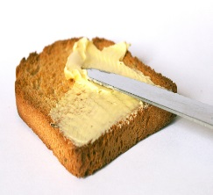
Fats
We all need a small amount of fat in our diets to help the body absorb vitamins and stay healthy.
While fats are essential in the diet, they contain high amounts of energy, so should be eaten in moderation.
There are different types of fats which play a different role in health:
Saturated Fat and Unsaturated fat

Slide 3

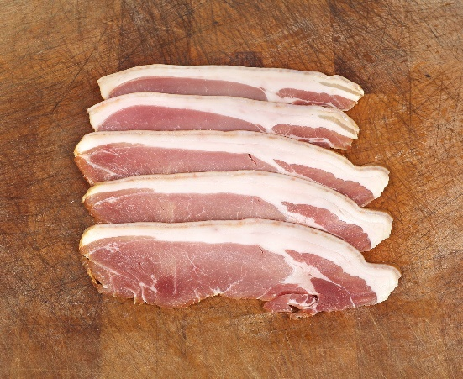
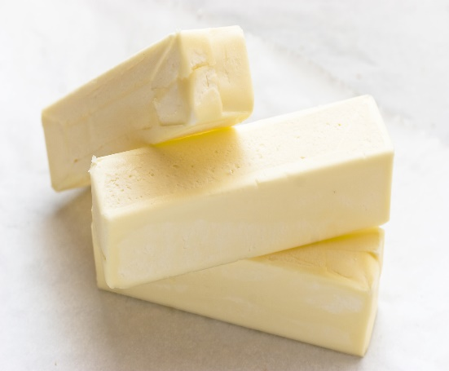
Fats
Saturated Fats
Mainly found in animal products e.g., meat and meat products, milk, cheese, butter and in pies, pastries, biscuits, cakes. Having a lot of saturated fat may be linked with raised levels of LDL cholesterol and heart disease.

Slide 4

Fats
Unsaturated Fats
Unsaturated fats can be either polyunsaturated or monounsaturated.
These types of fats can protect our hearts by maintaining levels of HDL cholesterol and reducing levels of LDL cholesterol.
Unsaturated fats can be found in rapeseed oil, sunflower oil, olive oil, corn oil and their spreads, oily fish, avocados, nuts and seeds.

Slide 5
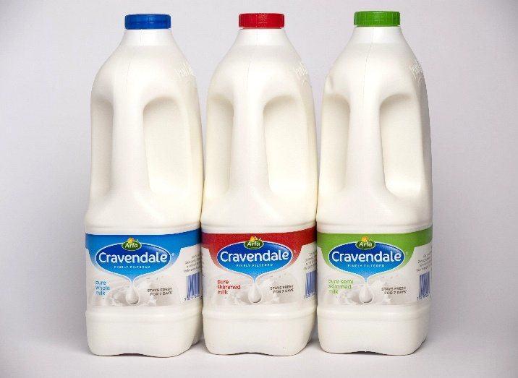
Fats
Top Tips for Reducing Fat Intake
Here are some simple practical tips on how you can cut the amount of fat your family eat, especially saturated fat:
Choose lean cuts of meat and cut off any visible fat.
Grill, bake, poach or steam rather than frying or roasting.
Use a measuring spoon when using oil, rather than pouring freehand.
Try reduced-fat dairy products, rather than full-fat.

Slide 6
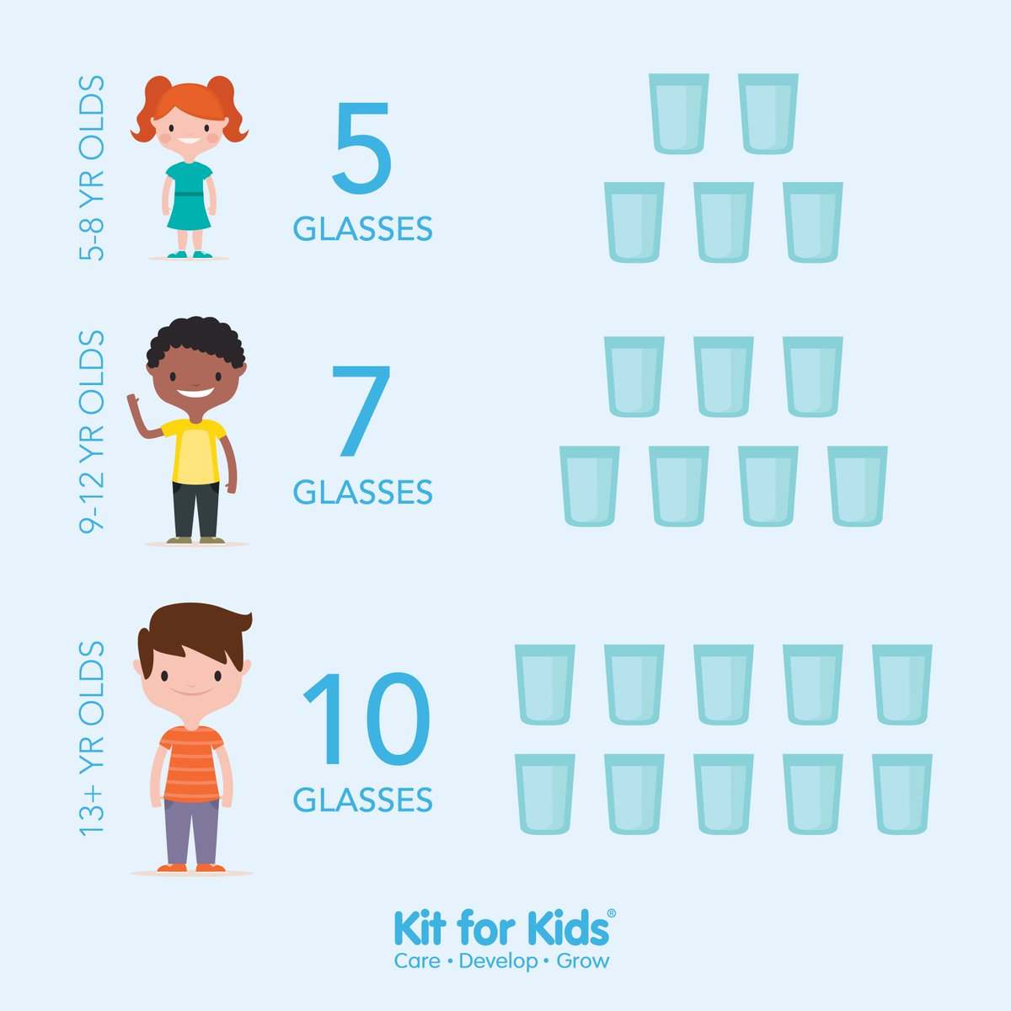
Hydration
How much water do we need?
Our body needs water or other fluids to work efficiently and to avoid dehydration.
Water helps us to digest and absorb food, carry nutrients and oxygen round the body in our blood, regulate our temperature, and help the body get rid of waste.
Water is a great choice for quenching your thirst at any time. It has no calories and contains no sugar that can damage your teeth. Aim to drink 6-8 glasses a day.

Slide 7
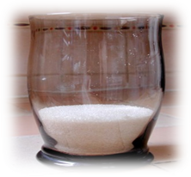

Hydration
Top Tips
Try to avoid sugary, soft, fizzy and energy drinks that are high in added sugar and caffiene. These can be high in calories, bad for teeth and contain very few, if any nutrients.
Sports drinks are useful if you are doing high level endurance sports and need an energy boost e.g., marathon running. These are generally not needed otherwise.
Milk is a good source of calcium that helps build and maintain healthy bones, it is also a great choice to rehydrate.
Try to limit intake of bought flavoured milks and milkshakes, try making your own milkshakes by blending fruit with lower fat milks.
Be careful of some juice drinks; they may only contain as little as 5% fruit juice and a lot of added sugar.

Slide 8
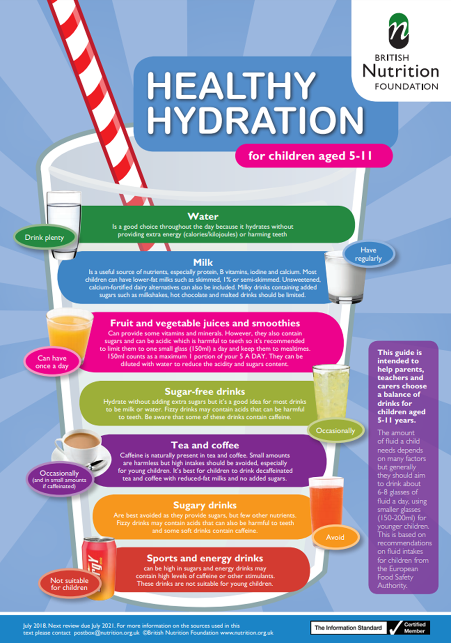

Slide 9
Sugar
How much sugar should we have?
Do you know the daily guidelines for sugar?

Slide 10
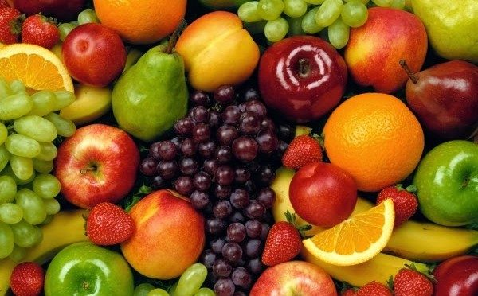
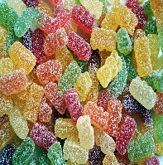
Sugar
Different types of sugar
Sugar occurs naturally in foods such as fruit (fructose) and milk (lactose). We don’t necessarily need to cut down on these types of sugars.
‘Free sugars’ are added sugars which include all sugars added to food and sugars naturally present in honey, syrup and fruit juice. These sugars are the ones found in cakes, sweets, biscuits, etc.
There are lots of different ways added sugar can be listed on ingredients labels such as: sucrose, glucose, fructose, maltose, molasses, hydrolysed starch, invert sugar, corn syrup, honey and many more.

Slide 11

Sugar
Top Tips to cut down on sugar
Try to keep to one glass of pure fruit juice or smoothie daily.
Milkshakes, hot chocolate and syrups added to hot drinks all contain high amounts of sugar, so try to have these on occasion or make homemade.
Try plain biscuits instead of chocolate or cream.
If you put sugar on cereal, try gradually cutting down, or replace with chopped fruit.
Instead of sugary fizzy drinks and juice drinks, go for water. If you have flavoured water check that it doesn’t have added sugar.
If you have sugar in hot drinks, try gradually reducing it.
Choose tins of fruit in juice rather than syrup.
Choose wholegrain breakfast cereal but not those coated with sugar or honey.
When shopping for yoghurts or cereal bars try to select the ones that are 100kcal or less per pot or bar.

Slide 12

Fats and Sugar
Helpful Tip
· For simplicity more nutritious foods should follow the following rule -
· Remember for low Fat we want 3g or below per 100g (Memory tip: Fat has three letters, think three grams)
· Remember for low Sugar we want 5g or below per 100g (Memory tip: Sugar has five letters, think five grams)

Slide 13
Resources
General resources - British Nutrition Foundation
HAF Sign Up - PhunkyFoods

