Slide 1
Welcome / Dynnargh dhywgh
www.healthycornwall.org.uk

Slide 2
An Introduction to School Food Standards and HAF Nutrition education guidance
In accordance with:
School food standards practical guide - GOV.UK (www.gov.uk) &
Holiday activities and food programme 2022 - GOV.UK (www.gov.uk)

Slide 3
HAF guidance on Nutritional education
Providers must include an element of nutritional education each day aimed at improving the knowledge and awareness of healthy eating for children. These do not need to be formal learning activities and could for example include activities such as:
Getting children involved in food preparation and cooking
Growing fruit and vegetables
Taste tests
Discussing food and nutrition
Including food and nutrition in other activities
Holiday activities and food programme 2022 - GOV.UK (www.gov.uk)

Slide 4
School Food Standards
Purpose:
“These school food standards are designed to help children develop healthy eating habits, and ensure that they have the energy and nutrition they need to get the most from their whole school day.” – Department of Education
This Photo by Unknown Author is licensed under CC BY-NC-ND
Notes:
Source: School food standards practical guide - GOV.UK (www.gov.uk)
Food should be served in a pleasant environment where children can eat with their friends
As a general principle, it’s important to provide a wide range of foods across the week. Use fresh, sustainable and locally sourced ingredients (best of all, from the school vegetable garden) and talk to the children about what they are eating.

Slide 5
What are the health consequences of poor eating behaviours
Excessive caloric intake | Increased risk of excess weight related diseases
High sugar intake | Increased risk of tooth decay and damage
High salt intake | Increased risk of high blood pressure, heart disease and stroke
Low fruit and vegetable intake | Increased risk of- Deficiencies in essenctial nutrients e.g. Iron, zinc and Vitamin A Reduced immunity Impaired development

Slide 6
National Child Measurement Programme (NCMP) 2019/20
National
Reception: 23.0%
Year 6: 35.2%
Cornwall and IoS
Reception: 25.1%
Year 6: 31.9%
Prevalence of overweight (including obese) children
Consistent early intervention for prevention is crucial
National Child Measurement Programme, England 2019/20 School Year - NHS Digital
Notes:
Recent data is unavailable at local authority level due to the Covid-19 pandemic affecting the ability to get into schools
National sample (10%) NCMP data shows an estimated prevalence increase both categories at the National level, however due to the sample size a true up to date estimate of local authority NCMP data is currently unavailable.

Slide 7
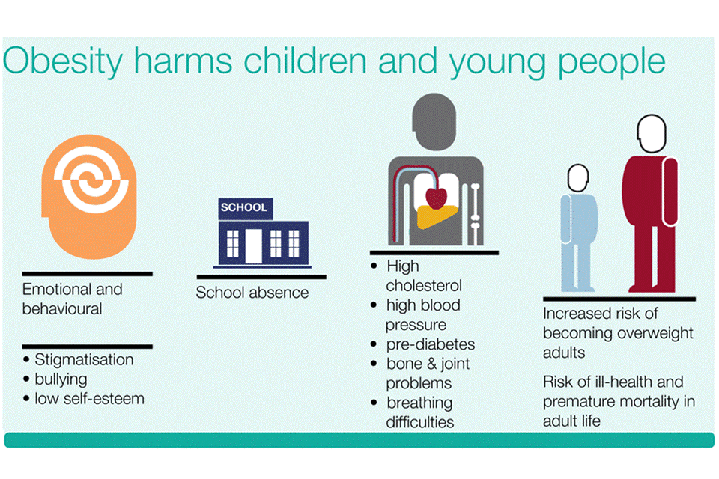
What is known….
Childhood obesity: applying All Our Health - GOV.UK (www.gov.uk)
Notes:
Sources: Childhood obesity: applying All Our Health - GOV.UK (www.gov.uk)
Notes:
Excess energy, high saturated fat, sugar and salt, and low intakes of fruit and vegetables, oily fish and fibre is associated with longer term health problems, including increased risk of heart disease, type 2 diabetes, stroke and some cancers.
It also has impacts beyond physical health, such as increased school absence and emotional/behavioural effects.
Importantly, overweight and obese children are also more likely to become obese adults, and have a higher risk of morbidity, disability and premature mortality in adulthood.
So it’s vital we tackle this unhealthy food culture at school.

Slide 8
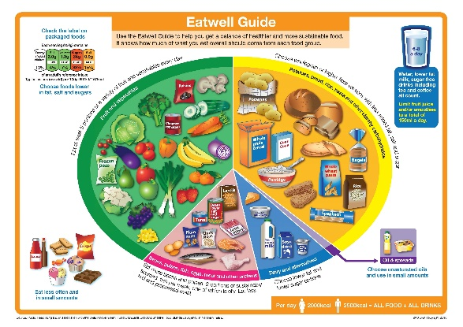
School food standards
What is a balanced diet?
A good variety of Fruit and vegetable
Plenty of Unrefined starchy foods
Protein (Meat, fish , eggs, beans and non-dairy sources of protein)
Milk and Dairy foods
Low/ minimal food & drink with high levels of fat, sugar and salt
School food standards practical guide - GOV.UK (www.gov.uk)
Notes:
Signpost to School food standards practical guide for approved meal ideas
Unrefined starchy foods= Complex carbs (Wholegrain and low sugar foods)

Slide 9
The School Food standards tea towel tool
School_Food_Standards_140911-V2e-tea-towel.pdf (schoolfoodplan.com)

Slide 10
Fruit and Vegetables
One or more portions of vegetables or salad to accompany each meal
At least one portion of fruit every day
At least three different fruits and three different vegetables each week
School_Food_Standards_140911-V2e-tea-towel.pdf (schoolfoodplan.com)

Slide 11
Milk and dairy
A portion of food from this group every day
Lower fat milk should be available
School_Food_Standards_140911-V2e-tea-towel.pdf (schoolfoodplan.com)

Slide 12
Starchy food
At least one wholegrain varieties of starchy food each week
At least one portion of food from this food group every day
At least three different starchy foods each week
Starchy food cooked in fat or oil should be no more than two days per week (Minimal is preferable)
Bread with no added fat or oil should be available daily
School_Food_Standards_140911-V2e-tea-towel.pdf (schoolfoodplan.com)

Slide 13
Food provided for outside of lunch
Fruit and/ or vegetable should be available in all provider food outlets
No Savoury Crackers and breadsticks
No cakes, biscuits, pastries or deserts (Except yogurt or a fruit based desert containing minimal 50% fruit)
School_Food_Standards_140911-V2e-tea-towel.pdf (schoolfoodplan.com)

Slide 14
Foods high in fat, sugar and salt
No more than two portions of food that has been deep-fried, batter-coated or breadcrumb coated, each week
Only snacks such as nuts, seeds, vegetables and fruit with no added salt, sugar or fat can be used
No more than two portions of food including pastry each week
Please try to avoid using desserts, cakes, biscuits and sweets
Salt should not be available to add once the food is cooked
Any additional Condiments should be no more than a 10g sachet or one teaspoon
Savoury crackers or breadsticks can be used at lunch if accompanied by fruit, vegetables or dairy food
School_Food_Standards_140911-V2e-tea-towel.pdf (schoolfoodplan.com)

Slide 15
Healthier drinks
A portion from this food group every day
For vegetarians and individuals not consuming animal produce a portion of non-dairy protein should be available
Consider a variety of protein sources
School_Food_Standards_140911-V2e-tea-towel.pdf (schoolfoodplan.com)

Slide 16
Healthier drinks
Free, fresh drinking water should be available at all times
Water
Fruit or vegetable juice with no added sugar (max 150mls)
Lower fat milk or lactose reduced milk
Dairy alternative milk
School_Food_Standards_140911-V2e-tea-towel.pdf (schoolfoodplan.com)
This Photo by Unknown Author is licensed under CC BY-NC-ND
Notes:
Notes:
Tea, Coffee, Hot chocolate are allowed (caveat with comments around caffeine and sugar)
Combination drinks are limited to a portion of 330ml. No more than 150 ml fruit or vegetable juice.
Fruit or vegetable juice combination drinks must be a minimal of 45% fruit or vegetable juice.

Slide 17
Some Apps to help with making healthier choices…

Slide 18
Please remember…
Role model health promoting behaviours
Avoid high sugar, salt and saturated fats
Promote the importance of a healthy relationship with food

Slide 19
This is the minimum not the gold standard!

