Slide 1

Wednesday 29th May 2019
Welcome to the
Healthy Workplace
Business Forum
Kindly Hosted by:
Cornwall Energy Recovery Centre
www.behealthyatwork.org

Slide 2

Today’s Presentations & Information
Natalie Chard
Graham Hicks: Healthy Workplace update
Jessica Murray: Karen Clifford Skin Cancer Charity Ambassador - Skin Cancer Prevention and Early Detection
Sheena Arthur: Age UK Cornwall – Wellbeing, Ageing and Working
Table stands:
Carly Titmus (Healthy Cornwall) Training Department
Amy Bromfield (Healthy Workplace) Healthy Weight in the Workplace
Ben Harris (Healthy Workplace) Physical Activity Offer
Information Station
Plus:
Mini tour at 12pm for approx. 20 minutes (there are a couple of spaces still available – see one of the team if you are interested)

Slide 3

Natalie Chard
Community Liaison Manager

Slide 4
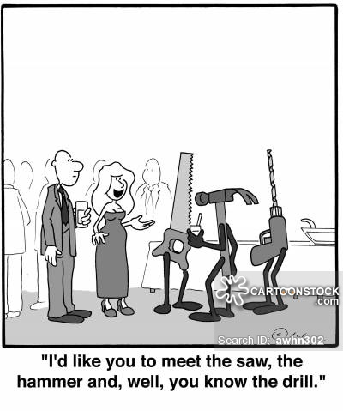
Audience participation time!
Let’s learn a little about each other.
Your name:
Who you work for & your title:
Two items you take out with you on a sunny summers day?

Slide 5
Graham Hicks
Healthy Workplace
Updates

Slide 6
The Healthy Workplace Team
Natasha Howard:
Healthy Workplace Team Lead
Amy Bromfield: Healthy Lifestyle Delivery Advisor: leading on weight management and healthy eating / Award Assessment and support
Lucy Brown: Healthy Lifestyle Delivery Advisor: leading on musculoskeletal health / Joint pain / the Micro Award specialising in supporting small businesses of 1-9 personnel plus; Award Assessment and support
Ben Harris: Healthy Lifestyle Delivery Advisor: leading on physical activity / Award assessment and support
Graham Hicks: Outreach Health Check Practitioner delivering free NHS Health Checks for people aged 40 – 74 years. Addressing: BP, Cholesterol, BMI etc. Assessing the risk of: Stroke and Cardiovascular disease in the next 10 years.

Slide 7




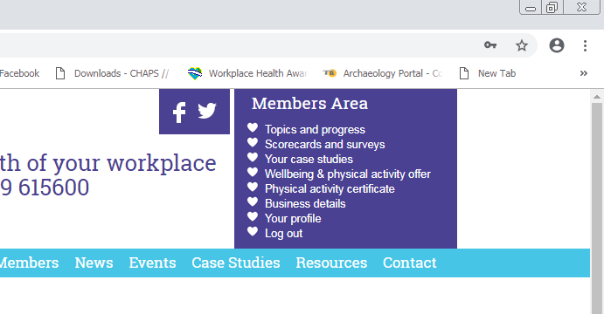



Wellbeing and Physical Activity Offer
A diverse range of wellbeing & physical activity partners offering free taster sessions or discounts for all Healthy Workplace members to promote to their staff to access & enjoy. Some of the providers are willing to come into your workplace and deliver sessions during lunchtimes or at other times during the day.
To access the Wellbeing and Physical Activity Offer just login and in the top corner you will see a purple box. Simply click on the wellbeing and physical activity offer to view the providers.
New Providers:

Slide 8



Healthy Workplace Award Assessments
are open until the end of November so book in your assessments soon as spaces are filling up!

Slide 9
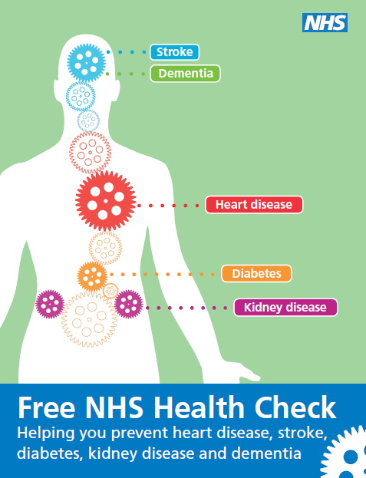
Free NHS Health Checks
To be eligible for a free NHS Health Check you must NOT have any of the following existing health conditions or exemptions:
NOT Attended a NHS Health Check in the last 5 years
You must be aged between 40 and 74 Years of age
You must live in Cornwall
ALSO: Have you been diagnosed with any of the following health conditions?
Coronary Heart Disease
Chronic Kidney Disease (CKD)
Diabetes
Hypertension (high blood pressure)
Atrial Fibrillation (irregular heartbeat)
Transient Ischaemic Attack (TIA)
Hypocholesterolaemia (high cholesterol)
Heart Failure
Peripheral Arterial Disease (reduction of blood flow clogged arteries, leg pain).
Stroke
Taking Statins
See Graham for dates & availability

Slide 10
Jessica Murray
Karen Clifford Skin Cancer Charity Ambassador
Skin Cancer Prevention and Early Intervention

Slide 11


Slide 12
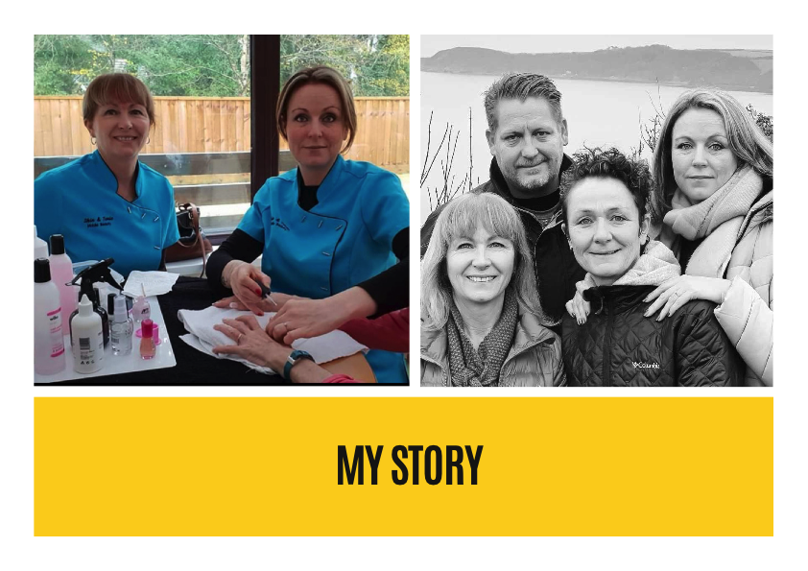

Slide 13
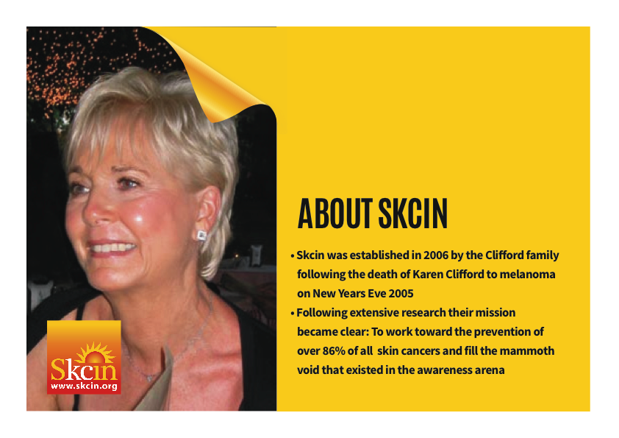

Slide 14


Slide 15


Slide 16


Slide 17


Slide 18


Slide 19


Slide 20


Slide 21


Slide 22


Slide 23


Slide 24
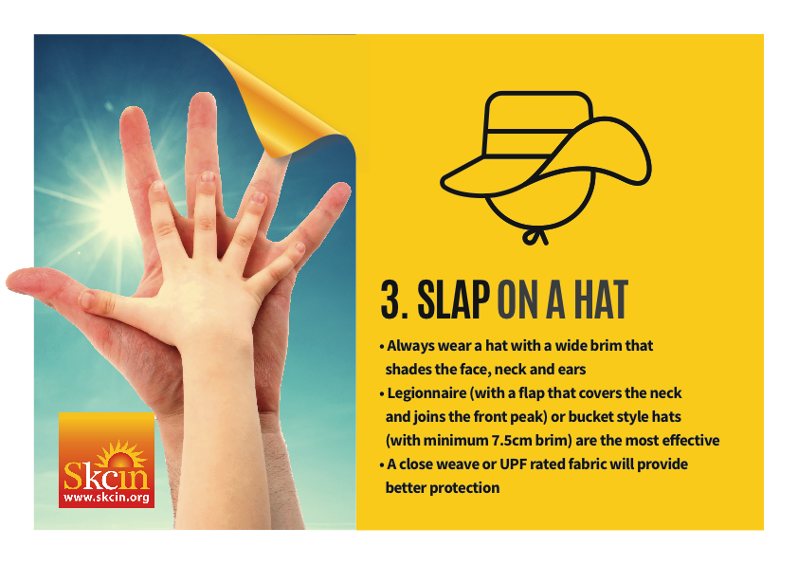

Slide 25


Slide 26


Slide 27


Slide 28
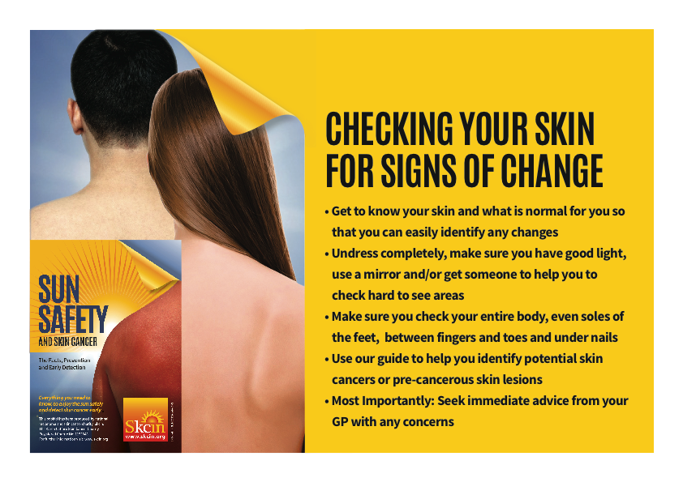

Slide 29
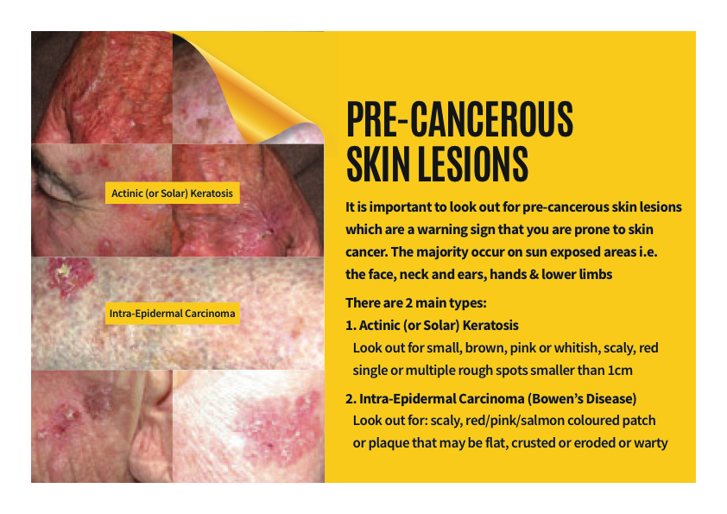

Slide 30
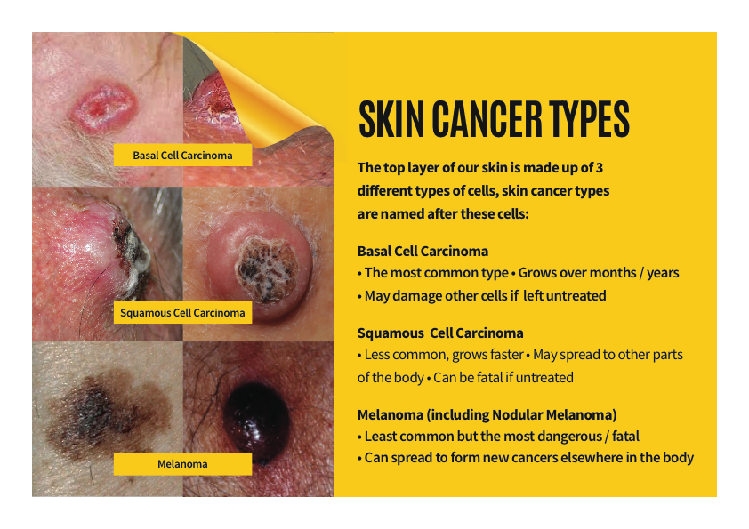

Slide 31
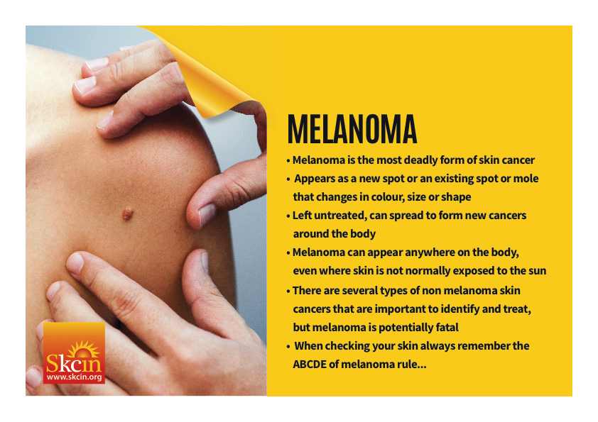

Slide 32
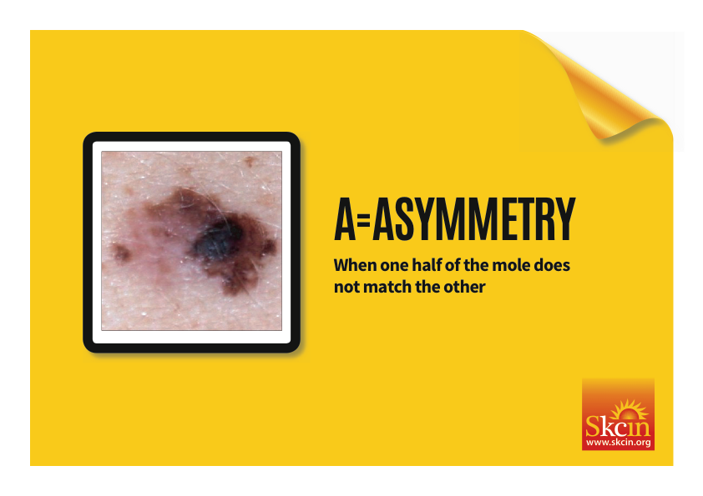

Slide 33


Slide 34
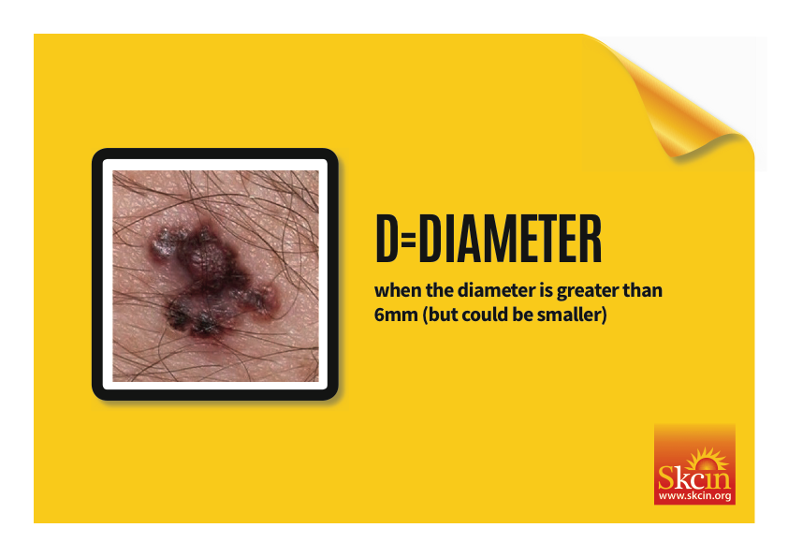

Slide 36
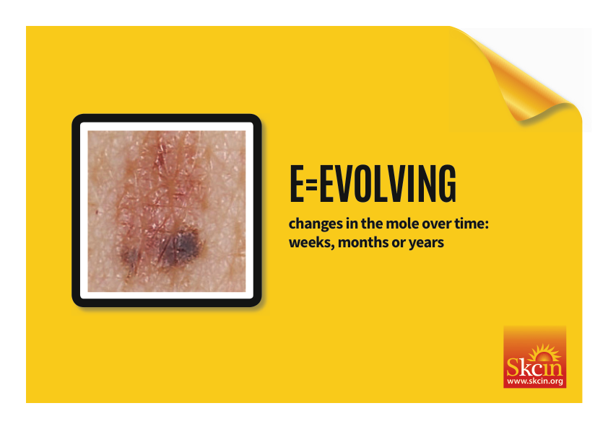

Slide 37


Slide 38
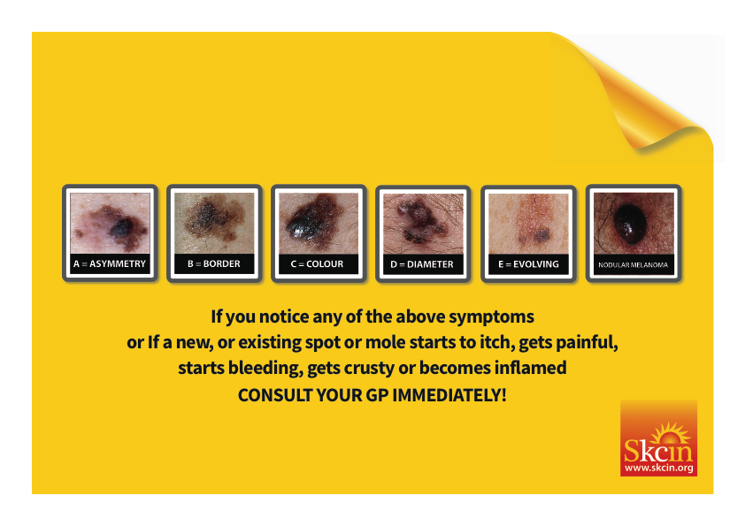

Slide 39


Slide 40
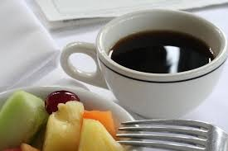
Time for a break
Please see: Amy for your chance to be weighed on the ‘Tanita’ Body Composition Scales

Slide 41
Sheena Arthur
Operations Manager - Age UK Cornwall
Healthy Ageing in the Workplace

Slide 42
Age UK Cornwall & The
Isles of Scilly
Sheena Arthur
Well-being, ageing and working
Notes:
Introduce yourself – welcome everyone

Slide 43
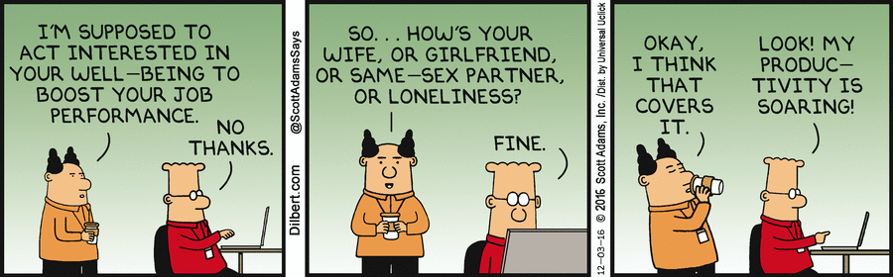
Making well-being a reality

Slide 44
Making well-being a reality
Quality of conversations
Creating time for support and supervision
Not making assumptions
People feeling listened to
People being listened to
Person centred approach

Slide 45
Good practice in the workplace
Flexibility
Respect, valuing the contributions of each person
Culture of learning- mentoring but also upskilling and development of older workers
Identifying strengths and weaknesses, not related to age
Mid life career review for 45-65 age group
Retirement planning
Notes:
Good practice suggested within ACAS paper re mid life career review, showed to help people feel valued and increased motivation and productivity.

Slide 46
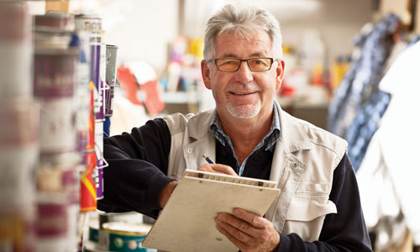
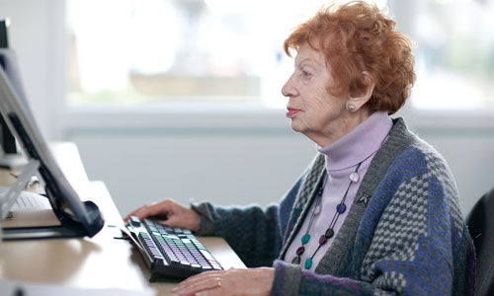
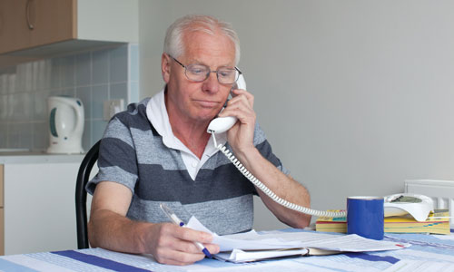
Caring for children
Caring for parents
Financial considerations
Being valued
Being useful
Supporting others
Health conditions
Confident and competent
Range of experience and strengths
Reduced stamina
Reduced dexterity
Reduced mobility
Notes:
What may be impacting the person?
Mobility, dexterity and stamina deteriorate sooner than mental capacity.
Health conditions related to ageing- menopause, cancer,
Adjustments may be necessary. Jobs are designed and they can be re-designed.
This group 45-65 may be carers in various ways- children, grandchildren, partners, parents.

Slide 47
Trust
Support
Development opportunities
Having a voice
Being useful
Flexibility
Professionalism
Valuing strengths
Redesigning jobs
Income
Accessibility
Transition planning
Notes:
What can businesses do to support older people and what do older people want from business
Age management is good management.
Age friendly working arrangements- equal treatment.
Recognise individual strengths and work with them.

Slide 48
Useful links
https://www.ageuk.org.uk
https://www.macmillan.org.uk/about-us/what-we-do/how-we-work/work-and-cancer
https://www.bbc.co.uk/programmes/articles/54LtT3wQ1LPkfFMZbCNkHCF/nine-tips-to-help-you-cope-with-the-menopause
https://www.cipd.co.uk/knowledge/culture/well-being/employee-financial-well-being#17459
http://www.acas.org.uk/media/pdf/f/i/Managing-older-workers-a-report-for-acas.pdf
www.cornwall.gov.uk/howareyou

Slide 49
Questions

Slide 50

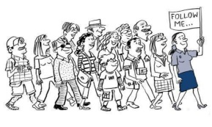
A big thank you to…
Natalie Chard
The Cornwall Energy Recovery Centre
Natasha, Amy, Lucy, Ben,
Carly, Jessica and Sheena
AND a BIG!
Thank you to: All of You for coming today.
The Mini Tour will start at 12noon

Slide 51
Dates for your diary:
Beach Games - Friday 6th September – don’t forget to enter your team!
Business Forum - Wednesday 13th November
(Men and Women’s health)

