Slide 1
Time2Eat
Practical Ideas
www.healthycornwall.org.uk

Slide 2
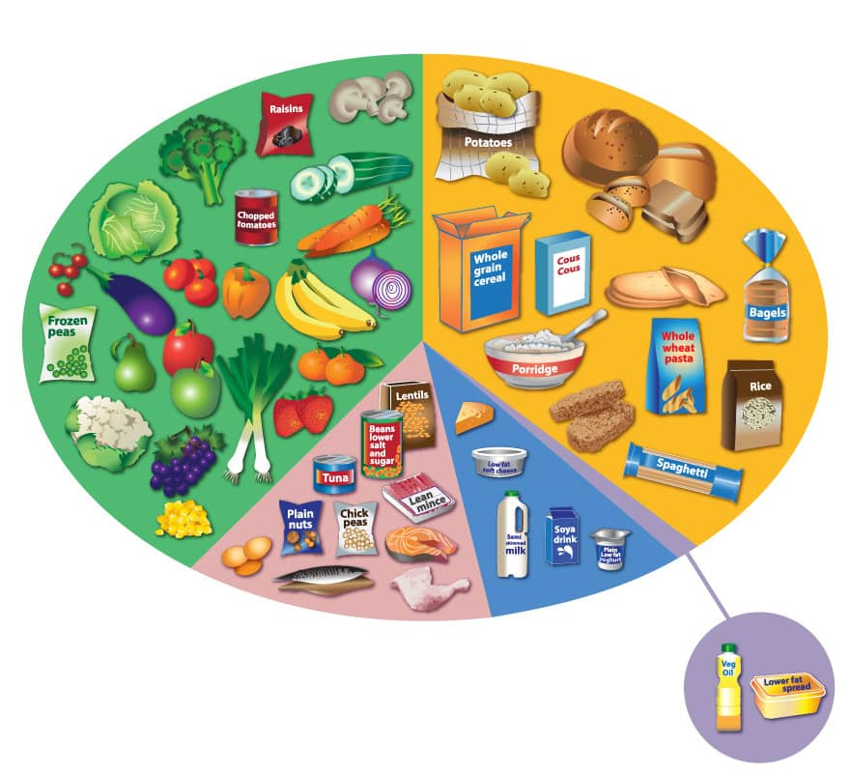
Topical Games
Eatwell Guide
A large eatwell guide with plastic foods or food pictures is a brilliant visual resource.
Children can take turns picking foods and placing them in the correct sections of the plate, discussions can then be had when trying to decide where it goes.
To introduce physical activity this can also be made into a relay.
Hide a seek – place the large eatwell guide in the centre of the room and hide the plastic food/pictures around room. On the whistle let the children run around finding the foods and bringing them back to the correct section of the plate

Slide 3
Topical Games
Label Reading
Do we need to read the labels on all foods?
To get the children thinking about processed and non-processed foods ask –
Imagine you are marooned on a remote desert island, there are no shops to buy food, no phones to call for a takeaway and no microwaves! But there is a big forest to explore, loads of plants and trees and don’t forget the island is surrounded by water! What foods do you think you might find? (Children should answer Meat, Fish, Fruits, vegetables, berries etc)
Ask the children to line up in the centre of the hall/court/field. Allocate one side as Yes/Green and the other No/Red.
Shout out a food (a mixture of staple and non-staple foods) and get the children to run to either side depending on whether they think that foods label needs to be read or not. Come back the middle and go again.
Staple food examples | Non Staple foods examples
Pasta Rice Bread Potatoes Fruit Eggs Vegetables Oats Milk Natural yoghurt Raw meat | Cereals Flavoured Yoghurts Crisps Jarred sauces Chocolates Cereal bars Soups Ready meals Chicken nuggets Sausages (processed meat)

Slide 4
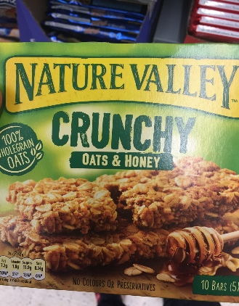
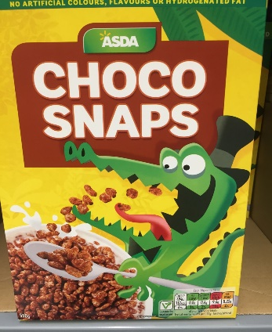
Topical Games
Label Reading
Label reading relay - lay all packs of the labels face down at the end of the hall. In teams line up at the other end. One person at a time from each team runs up and retrieves a laminated label and brings it back to the team.
Keep repeating this until all labels have been gathered , next teams need to but the foods into piles of less nutritious foods and more nutritious foods.
Alternatively for older children when picking up labels if it’s a more nutritious food bring it back to the team and if its not leave it there but facing up, run back and tag the next person. Continue until all nutritious food labels have been found. Winners are the team with the most labels .
For simplicity more nutritious foods should follow the following rule -
Remember for low Fat we want 3g or below per 100g (Memory tip: Fat has three letters, think three grams)
Remember for low Sugar we want 5g or below per 100g (Memory tip: Sugar has five letters, think five grams)

Slide 5
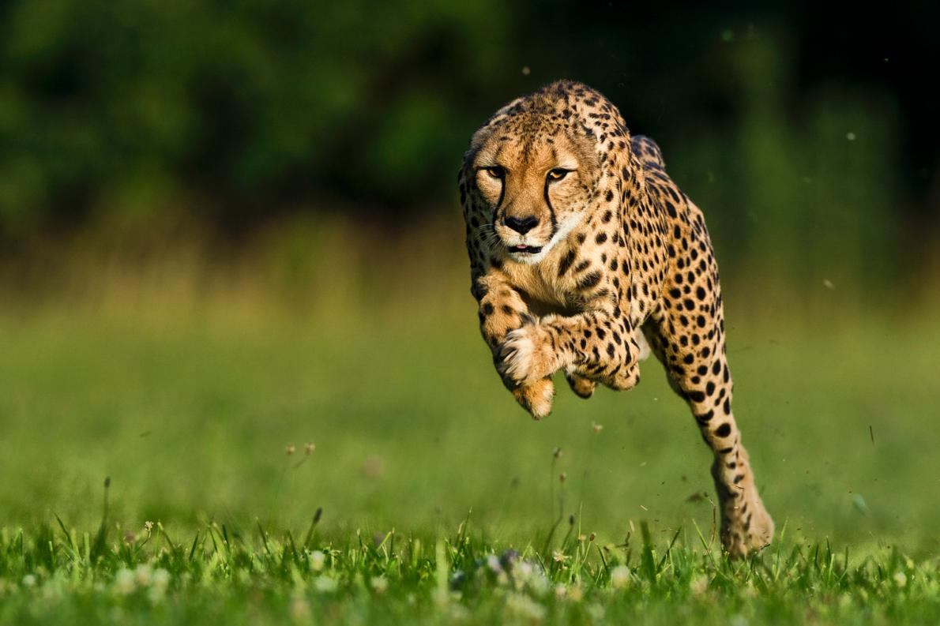
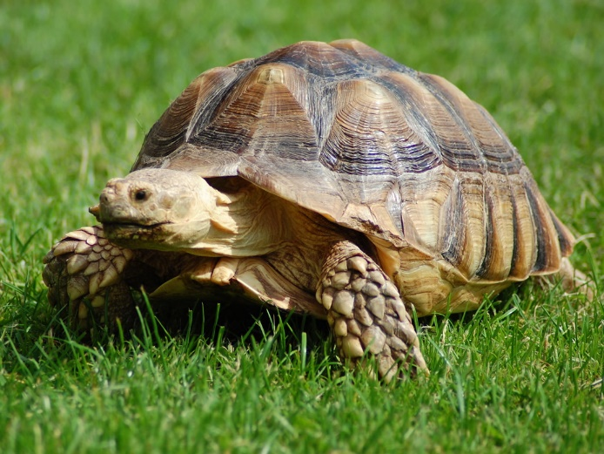
Topical Games
Fast and slow release foods
Get the children to spread out around the room. Explain how our bodies react to fast and slow release foods,
Fast release foods release energy quickly. This can lead to a burst of energy followed by a slump often leading us to want more quick fix foods.
Slow release foods release energy slowly keeping you fuller for longer and giving you energy throughout the day .
Leader can shout out a wide variety of foods (sweets, bananas, apples, peppers, vegetables, white bread/ brown bread , white pasta/brown pasta , chocolate etc).
If the children think it’s a fast release food they need to sprint around the room as fast as possible and then fall to the floor (out of energy). If they think it’s a slow release food they should move around in slow motion (releasing energy slowly).

Slide 6
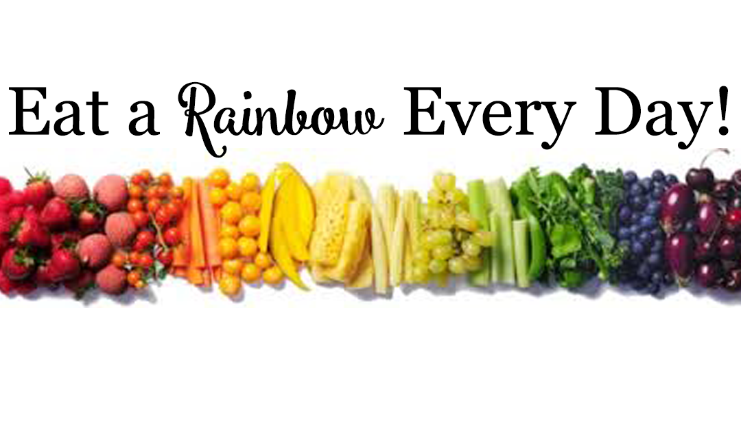
Topical Games
5 a day – Eat a rainbow
Eating a wide variety of different fruit and vegetables is essential to get all the different vitamins and minerals they contain. Eating a rainbow is a great way to get children to think about this as the different coloured fruit and vegetables each provide different nutrients.
Children can use a colouring sheet to think about all the different fruit and vegetables that could match the different colours of the rainbow.
This activity can also be replicated with plastic foods or pictures to make up a rainbow on the floor .

Slide 7
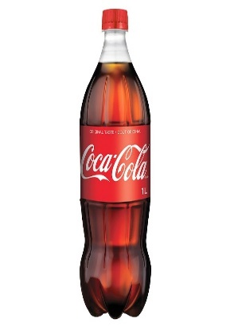
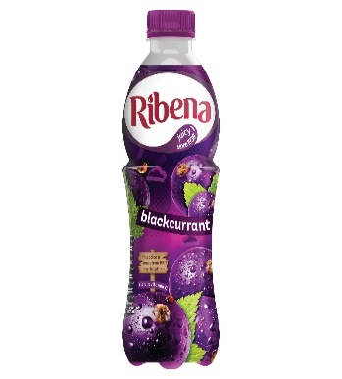
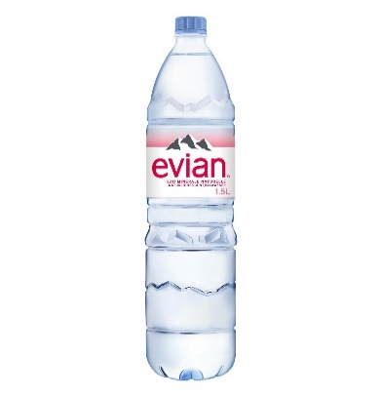
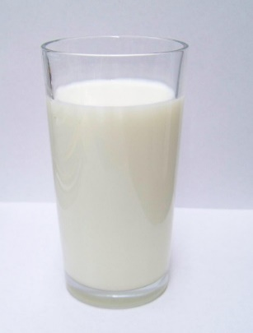
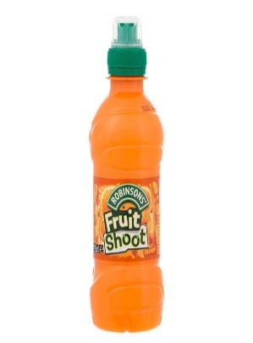
Topical Games
Sugars in drinks / Hyrdration
The amount of fluid a child needs depends on many factors but generally they should aim to drink about 6-8 glasses of fluid a day, using smaller glasses (150-200ml) for younger children. The best options are always milk and water!
What children drink is important as there can be lots of sugar in drinks, using a visual game to explain this can work well. Use a variety of different drinks and ask children to work out how much sugar is in each bottle and measure it out with teaspoons of sugar.
* 5g of sugar = 1 teaspoon of sugar

Slide 8
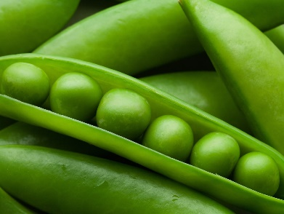
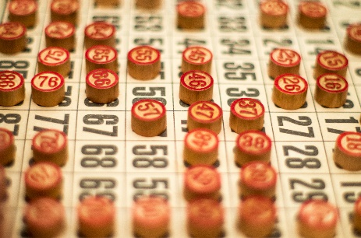
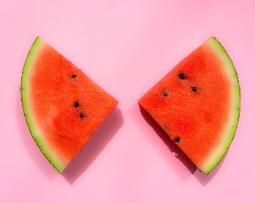
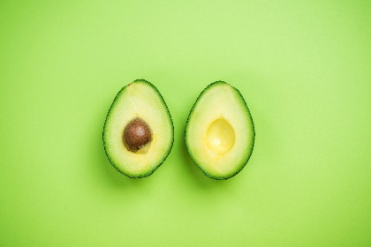
Topical Games
5 a day Bingo
Encouraging children to have 5 portions of fruit and vegetables per day can be difficult, be trying to make it fun through an active game can help.
Having a wide variety of these options on Bingo cards, can open up children’s minds to the types of fruits and vegetables that are available and that they may be willing to try. They might even find some that they had never heard of before!
You can create Bingo cards with various fruits and vegetables (generally 5 per card to encourage the 5 a day guidelines) and also create these foods on separate flash cards for the “Bingo coins”. Physical activity can be encouraged by using a sports hall or large facility ad placing the “Bingo coins” down the other end. The children can run or walk to retrieve a “coin”.

Slide 9
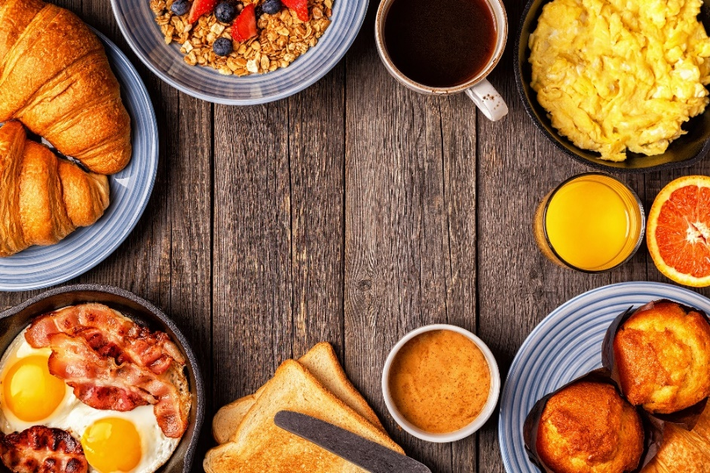
Topical Games
Fats in foods game
Food groups can be a tricky concept for children to understand. Having a practical activity to identify a characteristic of a food group, can allow for more development of understanding of food.
This activity is not there to put any negative emphasis on fats, but rather to highlight differences between the food groups; benefits, energy content, varieties, etc.
It is a good idea to have a few different foods/drinks to test. Oil, butter, milk, ham, etc can all be ideal foods with fat in them to test with. Orange juice, water, rice, porridge oats, are great contrasting foods to use too.
Rub each food on brown paper and let them dry… the foods with fat in them will leave a translucent “greasy” mark on the paper while the non-fat containing foods will not.

Slide 10
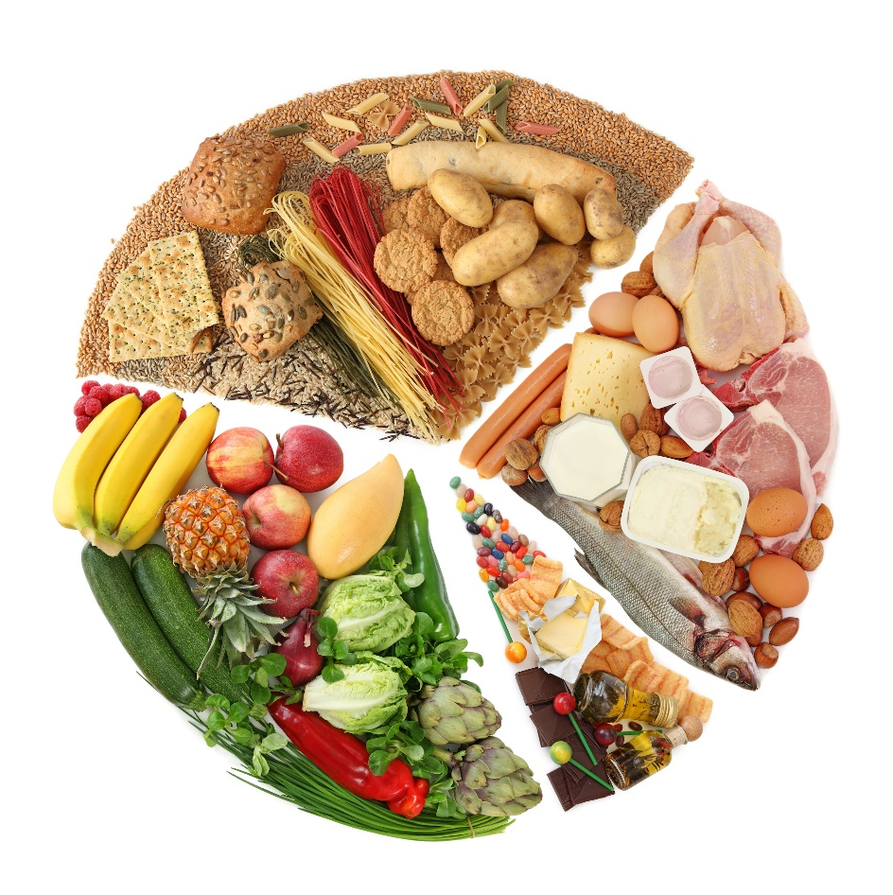
Topical Games
Fruit Salad
Discuss with the children the eatwell guide and its different sections.
Get the children to stand in a big circle (use spots or cones if needed)
Give each child a picture of a food.
Call out a food group. All the children in that food group leave their spot and change places with someone else in the same group.
Continue until all food groups have been called a couple of times.
Children can switch their food cards and play again.

Slide 11
Topical Games
What food am I?
Discuss the eatwell guide and its sections with the children.
Pin/tape or use headbands to attach pictures of different foods to children so they can’t see what they have.
Get the children to mingle and try to figure out what food they are by asking questions that can be answered “yes” or “no”. E.g. “ Am I part of the protein food group”. “Would you eat me for breakfast?”
Move on the another person after each question.
Once the child has guessed what they are they can continue to answer other questions

Slide 12
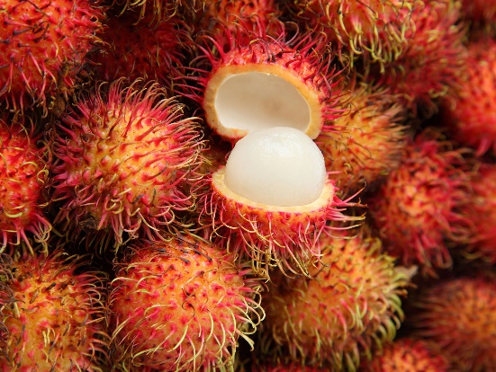
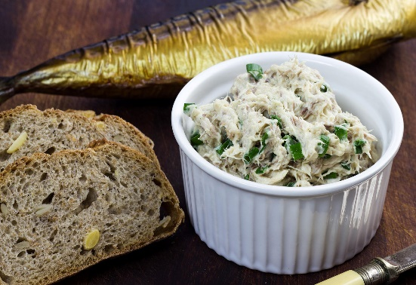
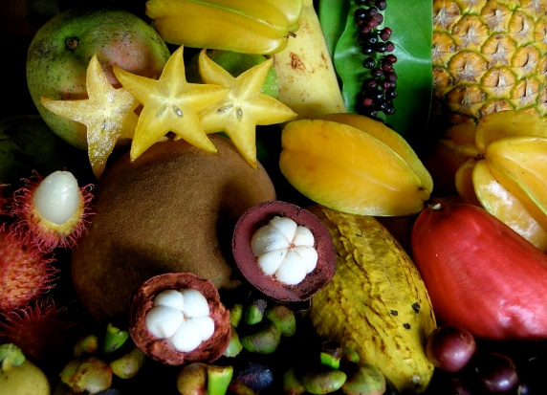
Topical Games
Taste Challenge
Children can often be fussy eaters and fall into a routine of eating the same foods.
Doing a taste challenge providing more obscure fruits and vegetables and strong tastes is a good way to challenge children to try something new.
It doesn’t matter if they don’t like it , it’s the trying that counts!
Try things like – lugumes, star fruit, pomegranate, avocado, olives, hummus , mackerel pate

Slide 13
Resources
Large eatwell guide
Plastic foods / food pictures
Hydration quiz
Variety of food labels
Eat a rainbow colouring sheet
Sugar in drinks game
5 a day bingo cards

