Slide 1
Time2Eat
Eatwell Guide
www.healthycornwall.org.uk

Slide 2
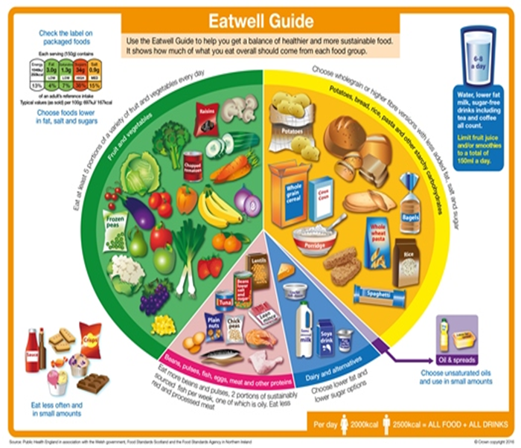
Eatwell Guide
The Eatwell Guide shows the different types of foods and drinks that are recommended and in what proportions to have a healthy, balanced diet each day .
Notes:
It divides the foods and drinks into five main groups - try to choose a variety of different foods from each of the groups to help you to get the wide range of nutrients your body needs.
The size of each section is proportional to the amount that is recommended to eat from each group per day not meal .
This model applies to adults and children over the age of 5. Between the age of 2-5 years children can move to eating the same foods as the rest of the family.
Children under 2 years need different proportions of foods as they are growing rapidly at this age.

Slide 3
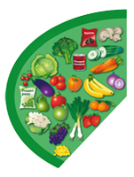
Fruit and Vegetables
We should all aim to eat AT LEAST 5 portions of fruit and veg a day.
This section makes up 1/3 of our diet
Fruit and vegetables are a great source of vitamins and minerals and fibre
All different colours contain different nutrients , so try to eat a rainbow
Can help protect the body from diseases, stroke and some cancers
Tinned
Fresh
Dried
Frozen
Juice/Smoothies
Beans and pulses
Notes:
Reference game – eat a rainbow
Discuss what counts ie frozen, tinned, dried etc
and what to be careful of ie dired fruit portions, syrup

Slide 4
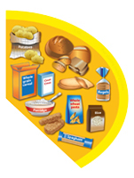
Carbohydrates
Potatoes, bread, rice, pasta, and other starchy foods
Starchy foods should make up 1/3 of our diet
They are great source of energy, and we should try to have a portion with every meal
They contain lots of fibre, iron and B vitamins
Wholegrain varieties are a good source of fibre and fill us up for longer we should try to eat these as much as possible.
Try and have more varieties
Choose fortified breakfast cereals that are low in added sugars
Potatoes
Cous Cous
Rice
Pasta
Oats
Bread
Wraps
Noodles
Notes:
Avoiding processed CHO sugary cereals, chips, waffles etc

Slide 5
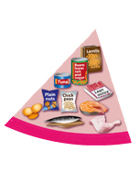
Protein
Beans, pulses, fish, eggs, meat and other proteins
These foods are great source of protein
Red meat is full of iron and a good source of vitamin B12.
Beans and pulses are cheap and a good source of a low-fat protein
Pulses count towards on of you 5 a day and can lower cholesterol
Try to have 2 portions of fish a week 1 of which should be oily.
Beans
Red meat
Eggs
Quorn/Tofu
Nuts and Seed
Fish
Lentils
Chicken/Turkey
Notes:
Eat around 2 portions a day (3 for vegetarians) per day e.g. breakfast and lunch or lunch and dinner
Try to limit processed meats (meats that have been changed) e.g. sausages, chicken nuggets and fish fingers
Try to eat fish at least twice a week, one of which should be oily (for omega 3)
Try to eat lean cuts of meat and skinless poultry whenever possible to cut down on fat. Always cook meat thoroughly.
You can choose from fresh, frozen or canned, but remember that canned and smoked fish can often be high in salt.
Eggs and pulses (including beans, nuts and seeds) are also great sources of protein.
Nuts are high in fibre and a good alternative to snacks high in saturated fat, they are high in energy so make sure you have a ‘me size’ portion!

Slide 6
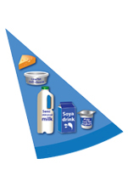
Dairy and alternatives
Milk, cheese, yoghurt
Milk and dairy foods are great sources of protein and calcium
They also contain lots of vitamins and minerals
Calcium keeps our bones and teeth strong and healthy
Choose low fat and sugar options
Children under 2 need whole milk as part of their diet however children over 2 can have semi skimmed.
Skimmed/semi skimmed milk
Cheese
Natural yoghurt
Soft cheese
Soya milk
Fromage Frais
Notes:
Aim to eat 3 portions from this food group each day
A portion is roughly two thumbs in size
Children over two can have semi-skimmed, or skimmed milk
Unsweetened calcium-fortified dairy alternatives like soya milks, soya yoghurts and soya cheeses also count as part of this food group, and can make good alternatives to dairy products.

Slide 7
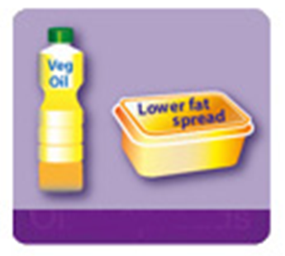
Fats
Oils and spreads
A small amount of fat is an essential part of a healthy, balanced diet.
Choose unsaturated oils and spreads and use in small amounts
Fat is a source of essential fatty acids, which the body can't make itself.
Fat helps the body absorb vitamins A, D and E.
All types of fats are high in energy and should be eaten in moderation
Olive oil
Vegetable oil
Rapseed Oil
Sunflower oil
Olive oil spread
Vegetable Oil spread
Notes:
These vitamins are fat-soluble, meaning they can only be absorbed with the help of fats.
Any fat not used by your body's cells or to create energy is converted into body fat. Likewise, unused carbohydrate and protein are also converted into body fat.
Offer 2 portions per day
Saturated fat and trans-fat can raise cholesterol and are found in processed food
Choose unsaturated fats. “monounsaturated” or “polyunsaturated”
A teaspoon full of oil counts as a portion
Choose lower fat spreads where possible

Slide 8
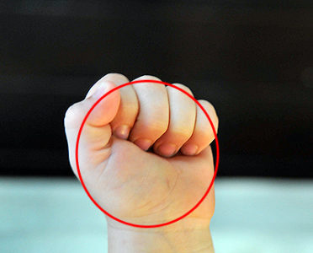
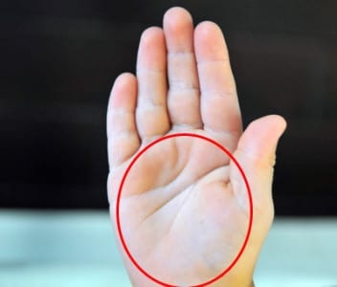
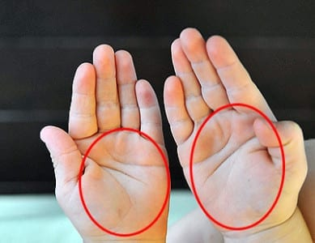
Portions
A simple guide to portion sizes
The amount of food that you eat at one time, for example, how much food you put on your plate at a meal or how much is in a packet
Using your own hand can be an easy way to check the size of your portions.
When serving up for someone else, use the size of their hand.

Slide 9
Portions cont …..

Slide 10
Portions cont ……..

Slide 11
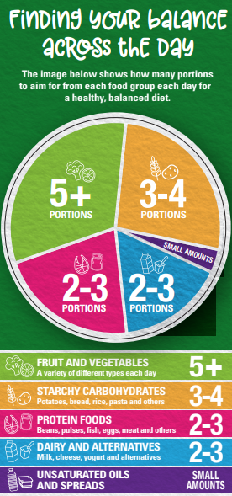
Portions cont ……..
Dairy
2 fingers is a portion of cheese
Fats
The tip of your finger is a portion of butter or a teaspoon of oil.

Slide 12
Useful links and resources
Resources - British Nutrition Foundation
Eatwell Guide [PDF] | Campaign Resource Centre (phe.gov.uk)
The Eatwell Guide - NHS (www.nhs.uk)
HAF Sign Up - PhunkyFoods

