Slide 1
Time2Eat
Label Reading
www.healthycornwall.org.uk

Slide 2
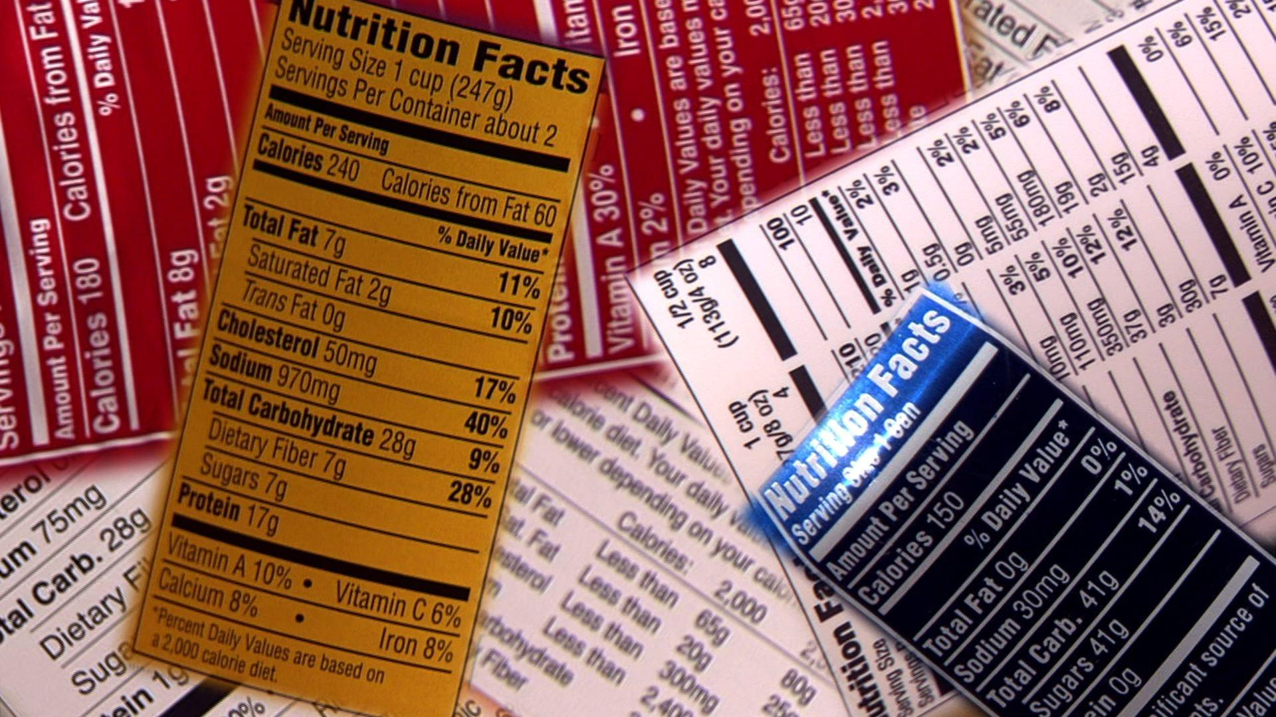
Label Reading
Food labels help us to make healthy food choices
Nutritional labels give you information which can help you make a healthier and more informed choice when deciding which food and drink products to buy. By educating children how to read food labels we can help them make informed choices about what they are eating.

Slide 3
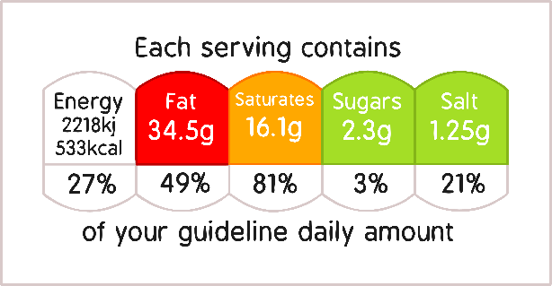
Label Reading
Traffic light system
The traffic light labelling system will tell you whether a food has high, medium or low amounts of fat, saturated fat, sugars and salt. It will also tell you the number of calories and kilojoules in that particular product.
It is mandatory for nutrition information to be displayed on the back of all food packaging, however some supermarkets and food manufacturers also display it on the front of pre-packed food in a handy traffic light system.
Using the traffic light label is very helpful when you want to compare the labels of different food products at a glance and helps you make a more informed choice.

Slide 4
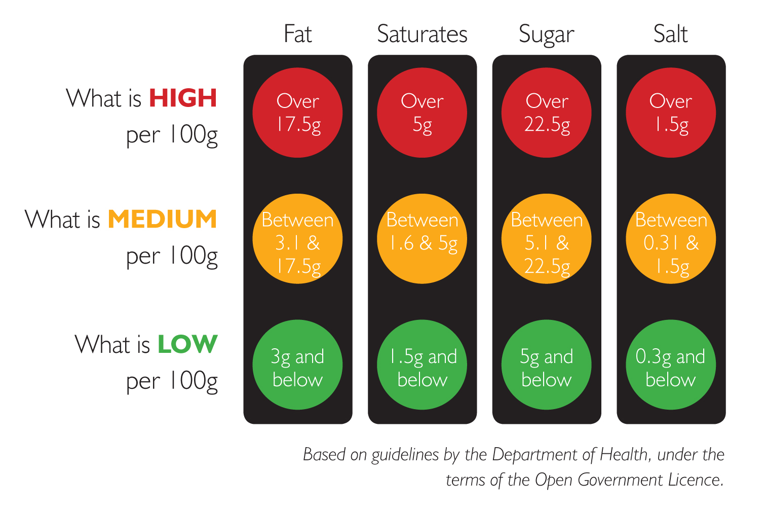
Label Reading
Traffic light system
This is an image of the traffic light label found on some foods. The traffic light label is colour coded and shows that green is low in a particular nutrient, amber means medium and red is high in a nutrient.
Red means the product is high in a nutrient and you should try to cut down, eat less often or eat smaller amounts.
Amber means medium. If a food contains mostly amber, you can eat it most of the time.
Green means low. The more green lights a label displays, the healthier the food choice is.

Slide 5
Label Reading
Traffic light system, things to be aware of!!!
The traffic lights are based on an adults not a child so something that is amber for an adult could be red for a child.
There are some foods that may be classed as red on the traffic light system however, are not necessarily foods that should be avoided. For example peanut butter at a glance may look like we shouldn’t have it yet is actually a good source of healthy fats. Serving size is important.

Slide 6
Label Reading
A top tip to help simplify for children
For simplicity more nutritious foods should follow the following rule -
·Remember for low Fat we want 3g or below per 100g (Memory tip: Fat has three letters, think three grams)
·Remember for low Sugar we want 5g or below per 100g (Memory tip: Sugar has five letters, think five grams)

Slide 7
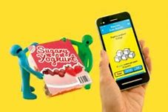
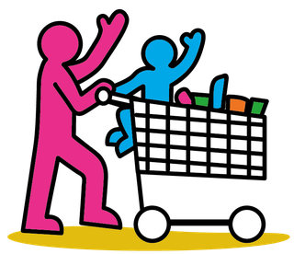
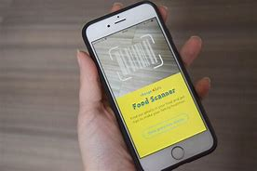
Label Reading
Food scanner app
SCAN , SWIPE, SWAP
This is a brilliant app to share with families. Families can just scan the barcodes of their favourite foods, and then swipe to see the healthier options available, and make a swap next time they shop.

Slide 8
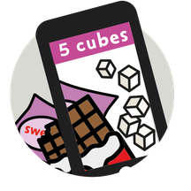
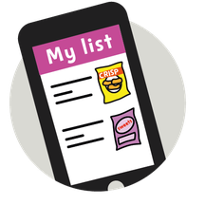
Label Reading
Food scanner app
Use the NHS Food Scanner to bring food labels to life! A quick scan of the barcode on the product's packaging using your phone's camera will show you:
If it's a 'Good choice'
Keep an eye out for the "Good choice" badge in the app, and when you're shopping in store or online.
Traffic light ratings
See at a glance whether the product is high, medium or low in sugar, salt and fat.
Living labels!
A fun augmented reality feature helps you celebrate your good choices – or bring the sugar, salt and fat in a product to life to help kids understand more about what they're eating.
All your previous scans
See the full list of every product you've ever scanned!

Slide 9
Label Reading
More information and leaflets
For more information on label reading you can watch the following video by the Food Standards Agency
Check the label | Food Standards Agency

